Slide 1
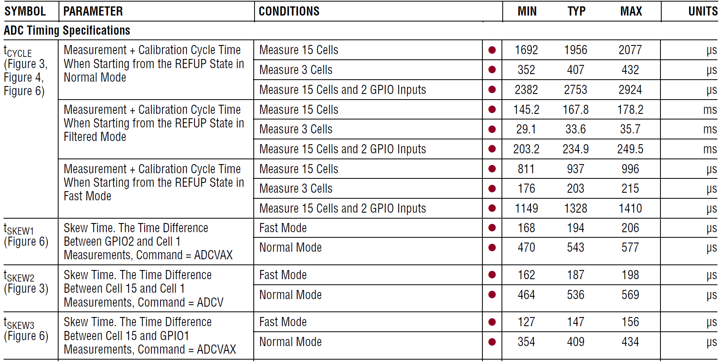
LTC6812 PCN Datasheet Changes
 | MIN (OLD) | MIN (NEW)
t_{CYCLE} | 1692 | 1455
 | 352 | 303
 | 2382 | 2049
 | 145.2 | 124.9
 | 29.1 | 25.0
 | 203.2 | 174.8
 | 811 | 697
 | 176 | 151
 | 1149 | 988
t_{SKEW1} | 168 | 144
 | 470 | 404
t_{SKEW2} | 162 | 139
 | 464 | 400
t_{SKEW3} | 127 | 109
 | 354 | 304
LTC6812-1

